Slide 1
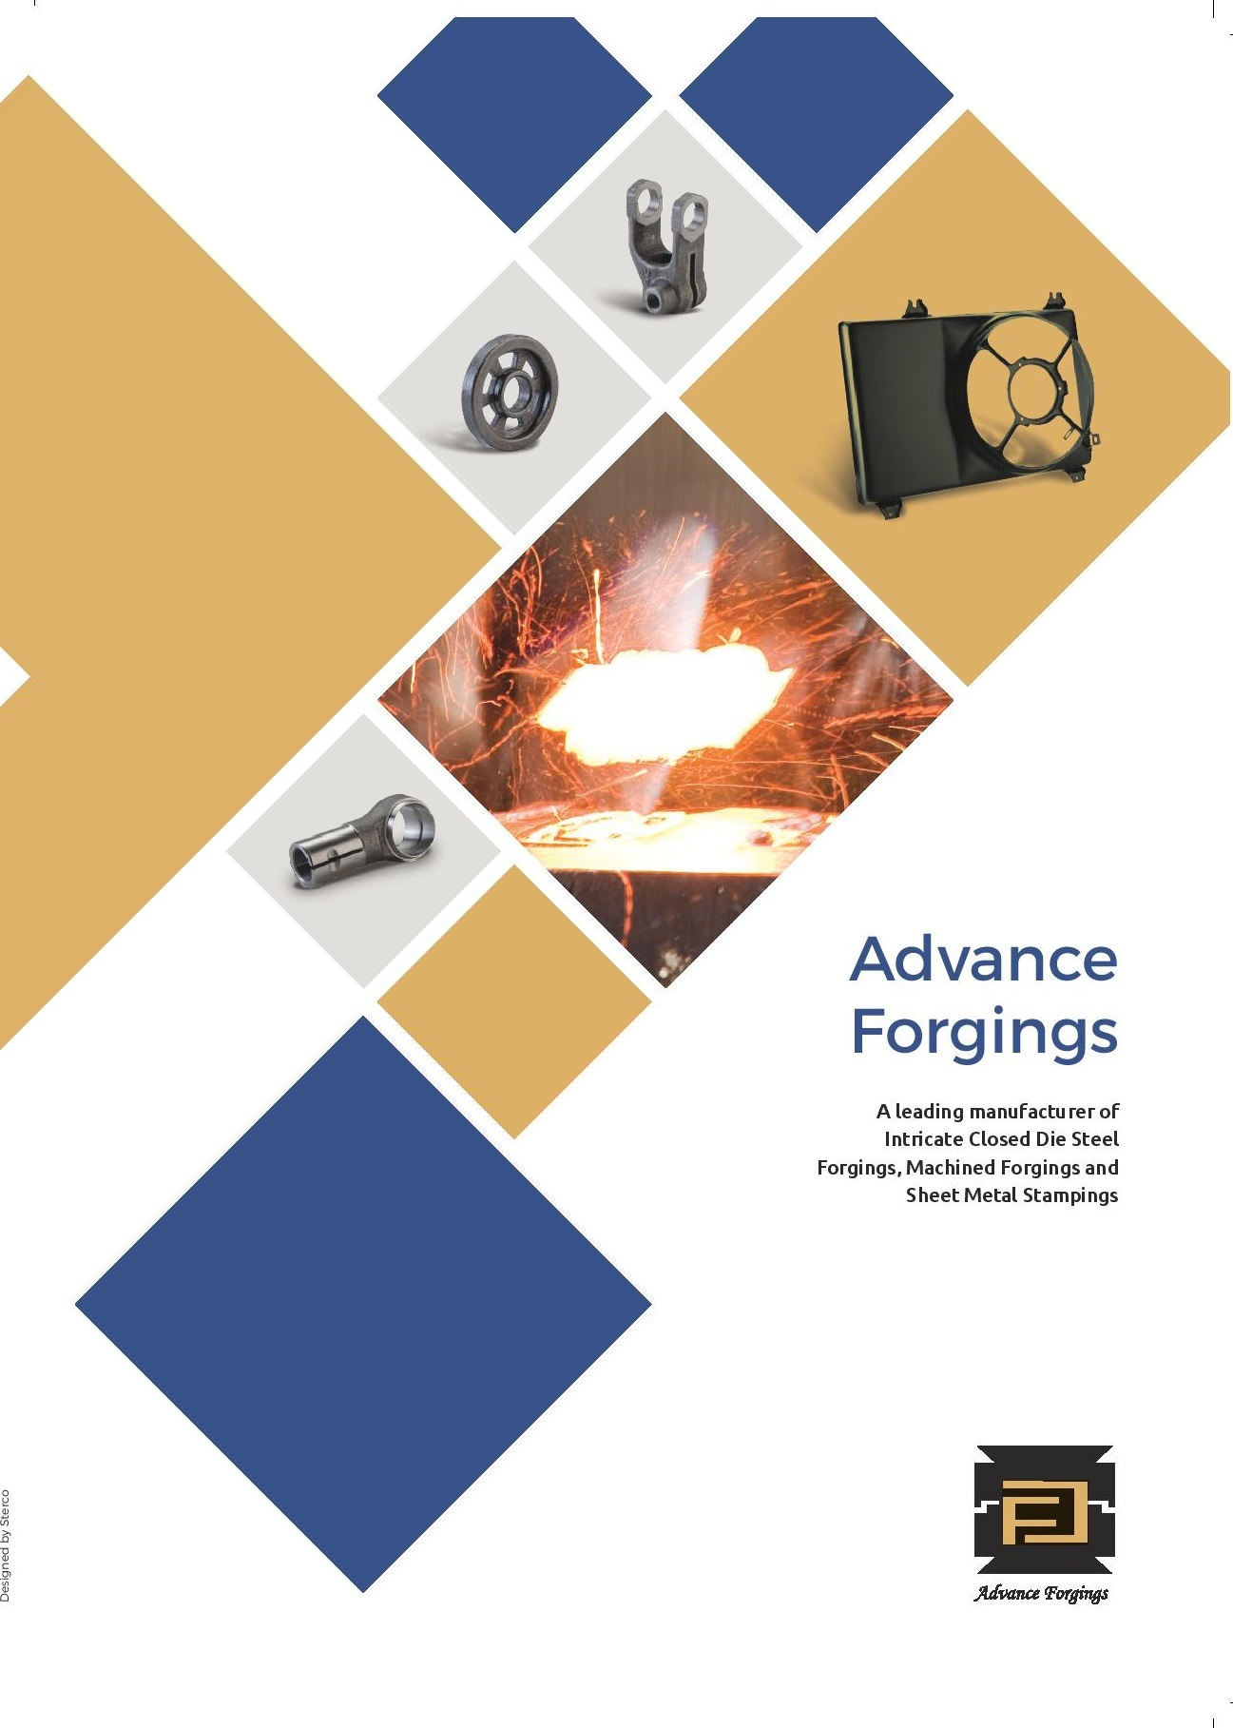

Slide 2
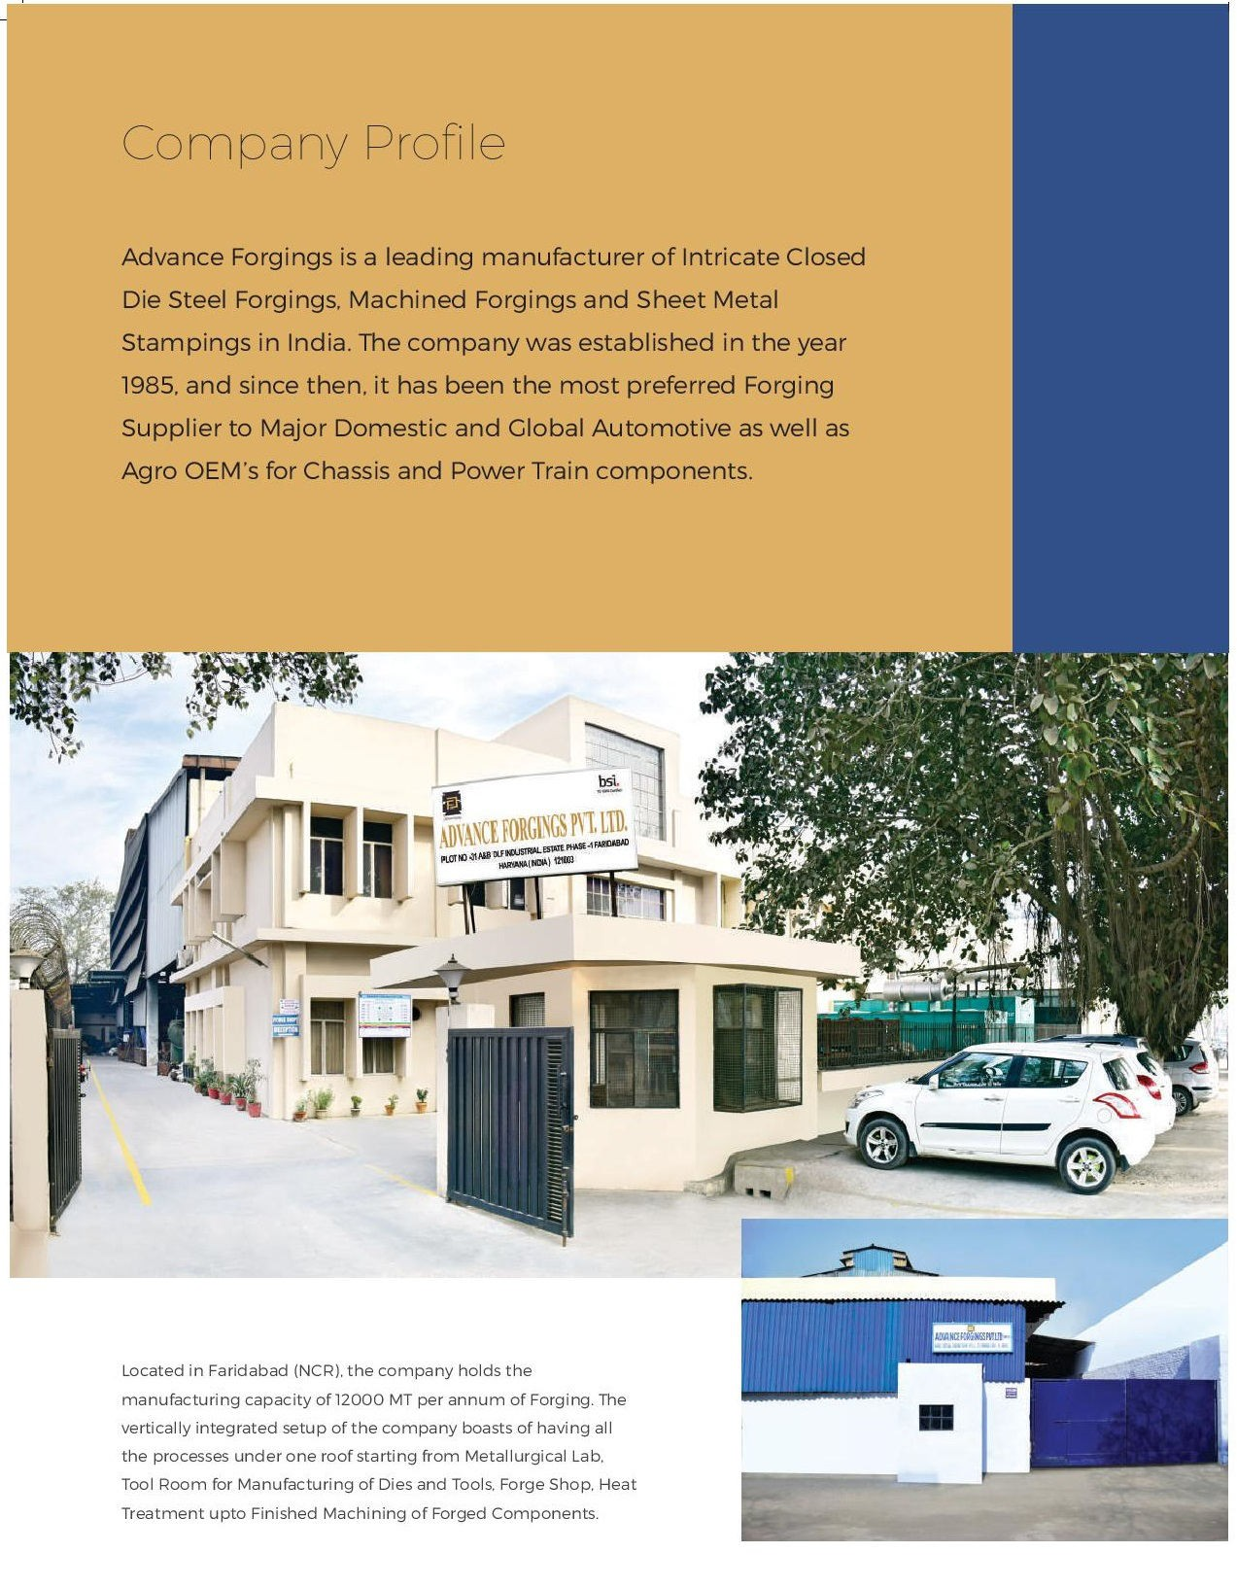

Slide 3
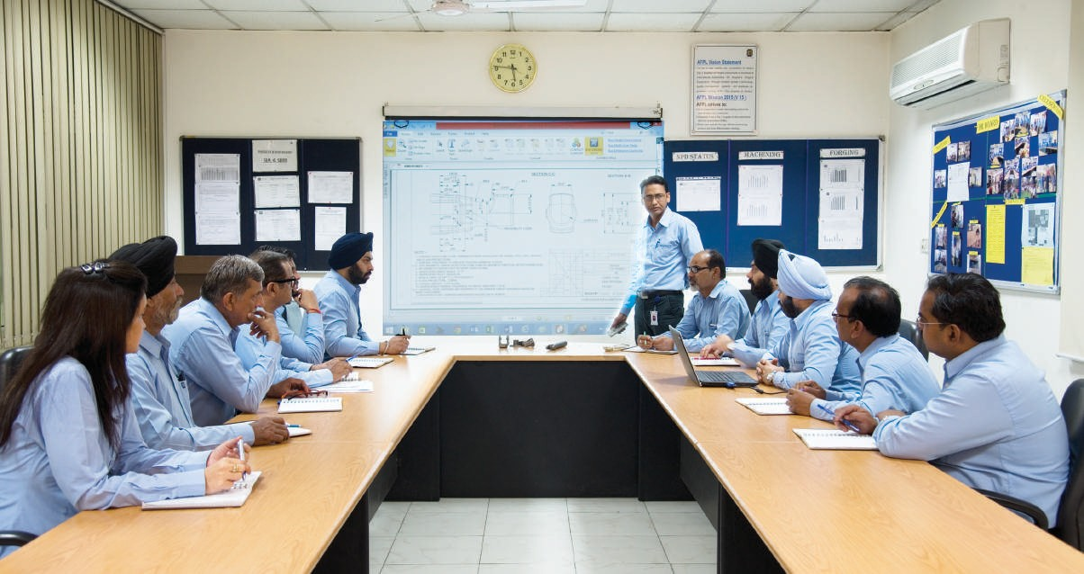
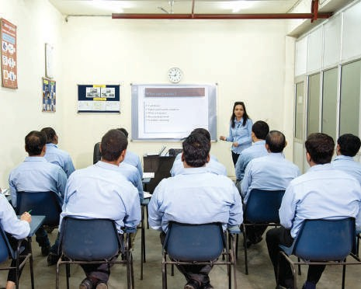
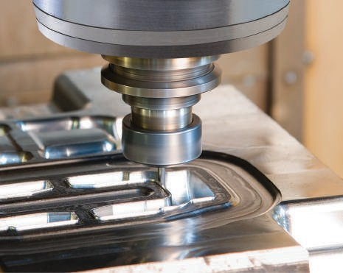
The company’s Sheet Metal Division with an annual manufacturing capacity of 1000 MT, provides a comprehensive range of stamping products for a wide range of applications. The company has in-house facilities for Die Making, Press Shop, Fabrication Shop (Mig Welding, Spot Welding) and all other required capabilities to meet the assemblies, sub-assemblies and other stamping requirements of major OEMs.
The core strength of the company lies in manufacturing Critical Proﬁle Components for Automotive industry majors. The company holds the market leadership position in Forged Steering Yokes manufacturing 15 Million Yokes per annum, making us the largest manufacturer of Steering Yokes in India for major automotive OEM’s.
New - Age Technology
The company has earned prestigious certiﬁcations such as TS 16949: and CQI-9 for Heat Treatment. Advance Forgings is also an active member of Industrial Associations such as ACMA, AIFA, MACE and FIA to keep up with the latest innovations in the ﬁeld of Technology and Quality.

Slide 4
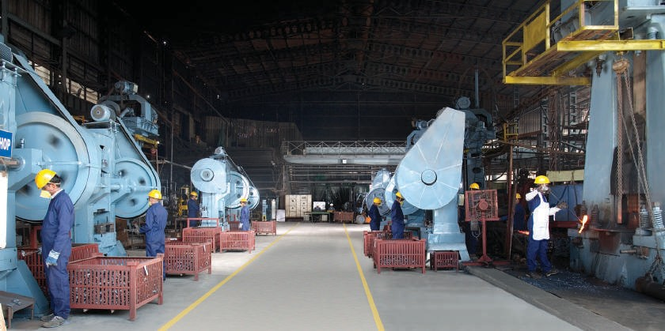
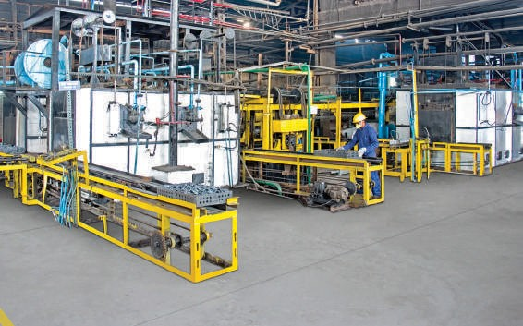
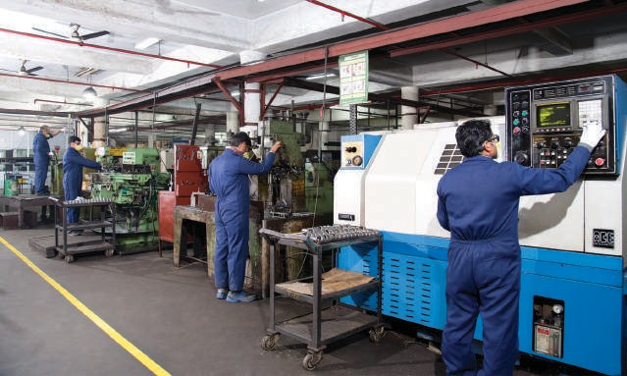
Largest Forging Manufacturer of Steering Yokes in India, Forging 15 million Yokes per annum
Infrastructure
By adopting TPM & TQM practices, Advance Forgings has ushered into an era of objective changes in superior modes of production and quality. Its integrated manufacturing units are located in Faridabad (NCR) for Forging, Machined Forgings & Sheet Metal Stampings.
Forging
The Forge Shop is equipped with Hammers and Presses to render high quality products for its customers with a wide range of proﬁle & round components ranging from 100 grams to 10 kilograms. These forgings are supplied to diversiﬁed industries such as Automotive, Agro, Railways, Earth Moving, Oil-Field and Cargo.
Heat Treatment
The company has continuous type heat treatment facility for Hardening, Tempering, Normalizing and ISO Thermal annealing with a capacity of 500 Kgs/Hr respectively. The facility ensures that right metallurgical structure of forging is achieved as per the desired customers’ speciﬁcations for high ﬁeld life.
Machining
The machining setup at Advance Forging is equipped with VMCs, CNCs, Horizontal Milling and Broaching Machines to add value to the forgings and provide Finished Machined Components as per customers’ speciﬁcations.

Slide 5
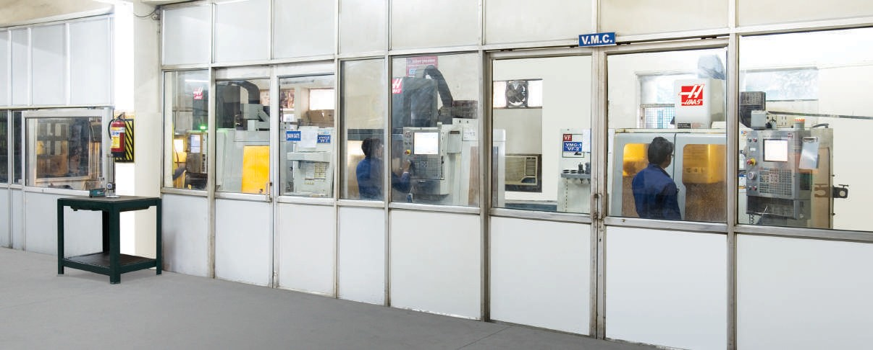
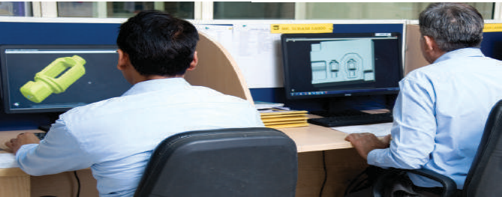
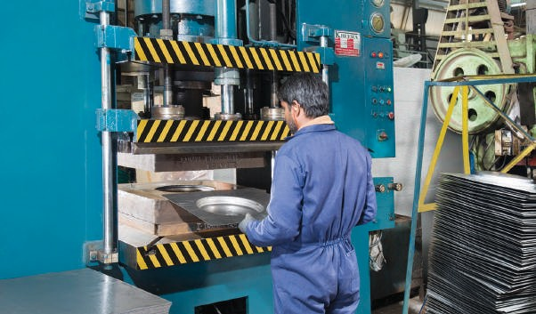
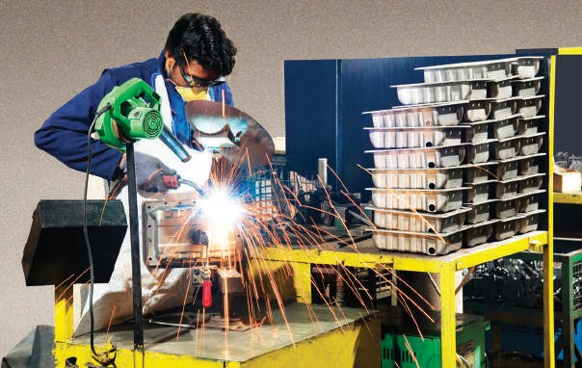
Engineering & New ProductDevelopment
This division is equipped with latest software to design and test prototype components with focus on ultimate applications. As the livewire link between the design and production stages, the engineers at the company also conceptualize products to suit the precise customers’ speciﬁcations. It has updated tool room equipped with High Precision VMCs to manufacture all the required tooling and dies in-house for Forging, Machined Forgings & Sheet Metal Stampings.
Supplying Finished
Sheet Metal Assemblies to New Holland Tractors
Sheet Metal Stamping
The Sheet Metal Stamping Division is equipped with in-house Tool Room, Press Shop, Weld Shop and Surface Treatment Plant to manufacture and supply
ready-to-ﬁt sheet metal components as per customers’ speciﬁcations. The facility has the capacity to Draw 0.8 mm - 2 mm thick sheet upto 200mm depth and Bending upto 10 mm thick sheet respectively.
Fabrication Shop
The Fabrication Shop consists of Mig & Spot Welding Machines to provide ready-to-ﬁt assemblies to major OEMs.

Slide 6
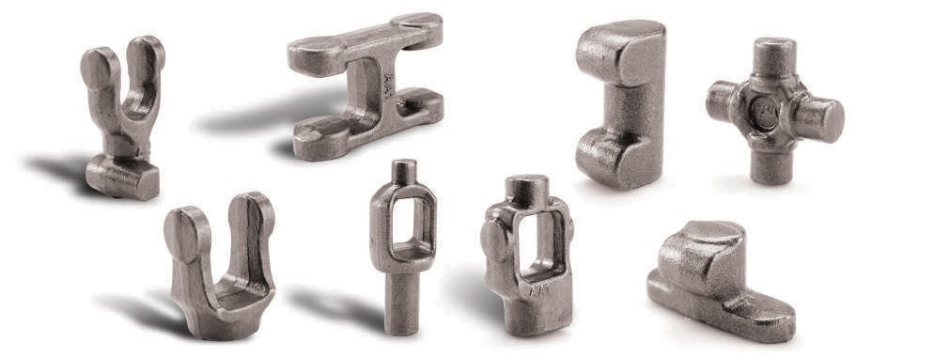
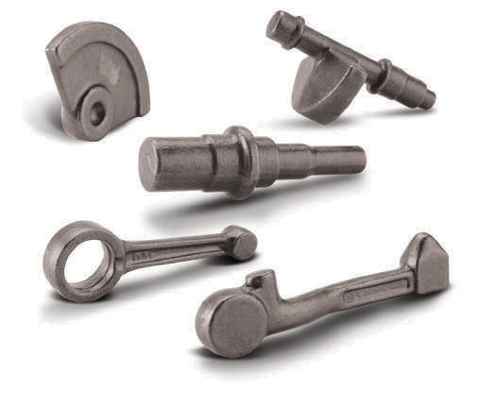
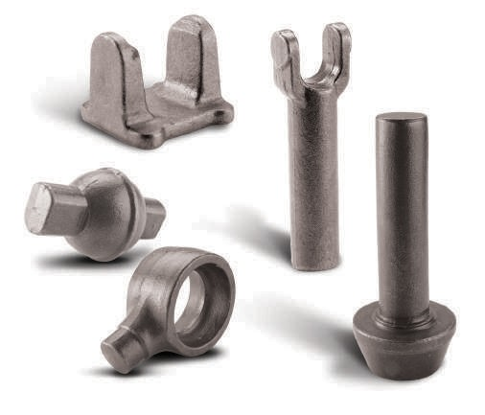
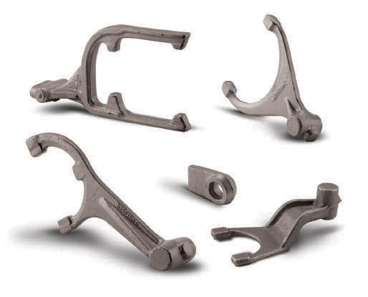
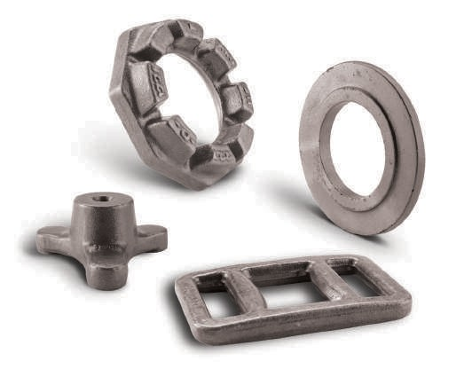
Products
Forging
Passenger Vehicles
Two and Three Wheelers
Commercial Vehicles
Other Industries
Agro - Tractor
Various Applications

Slide 7
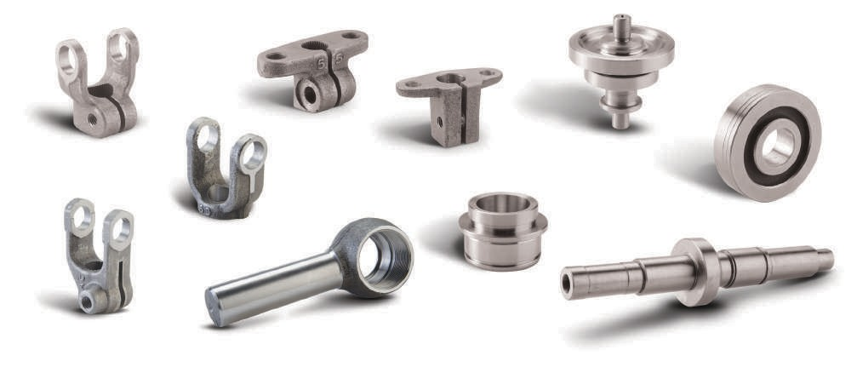
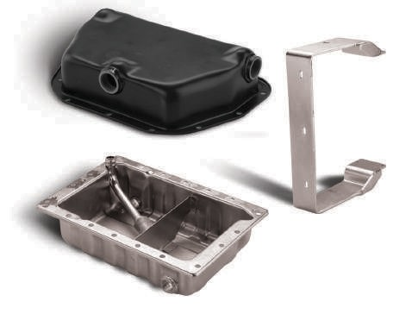
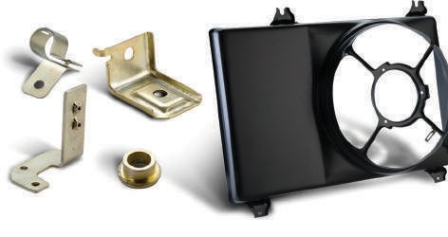
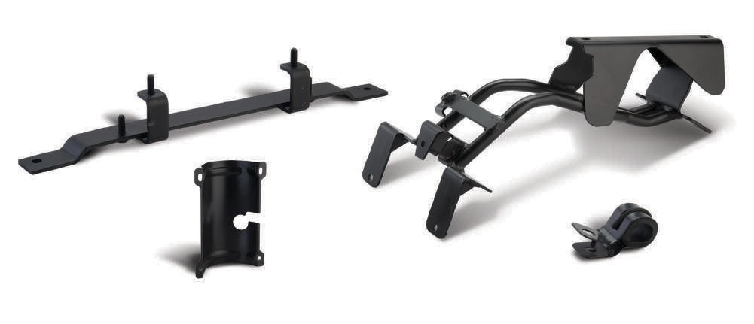
Machining
Machined Forgings
Sheet Metal
Passenger Vehicles
Other Industries -Stationary Engines
Agro - Tractor

Slide 8
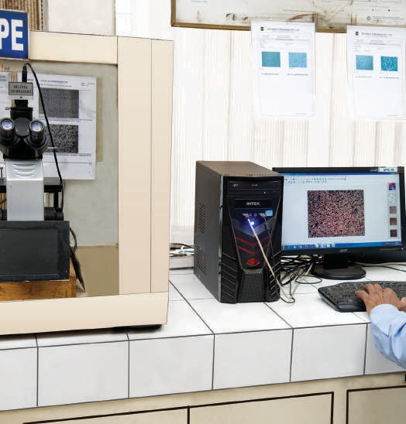
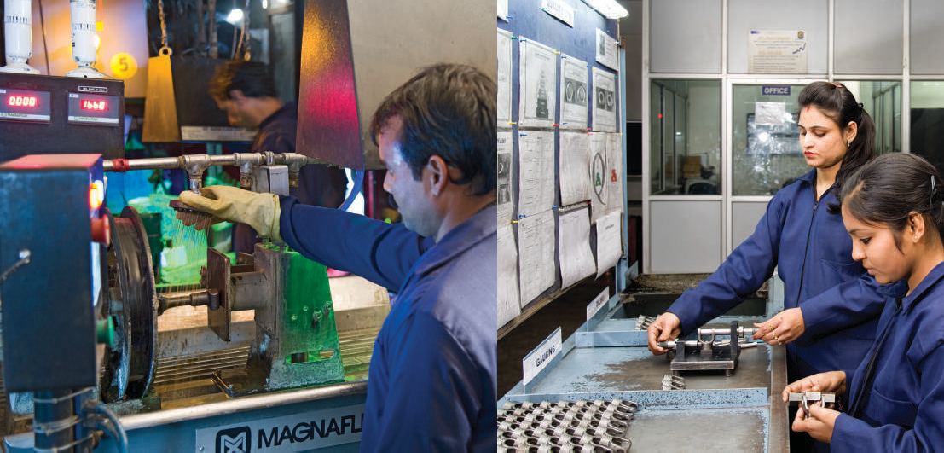
Quality Policy
Advance Forging’s quest for excellence in achieving ‘Customer Delight’ has enabled us to adhere to the highest standards in quality. The Total Quality Management (TQM) has been an integral part of the company’s success.
With focus on ‘Quality First’, we are designing, manufacturing and supplying some of the most Intricate Closed Die Steel Forgings, Machined Forgings and Sheet Metal Stampings.
Defect-free manufacturing of components
Motivation and Training of employees for continuous improvement
Cost-effectiveness and Delivery compliance
Customer Delight

Slide 9
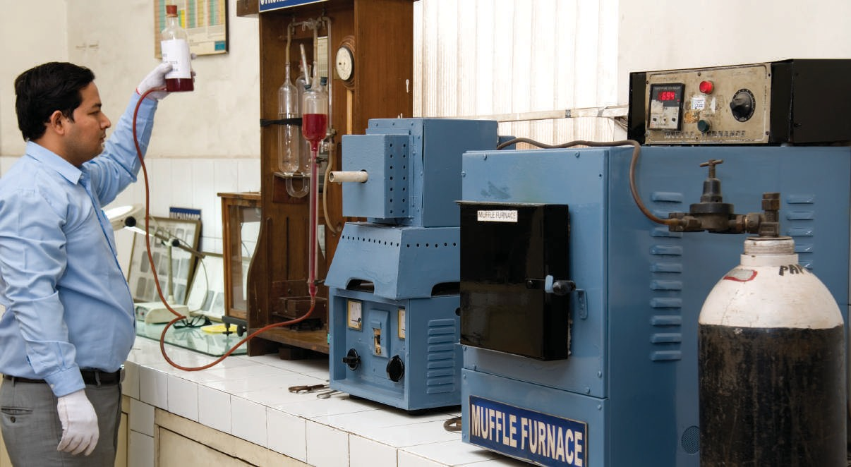
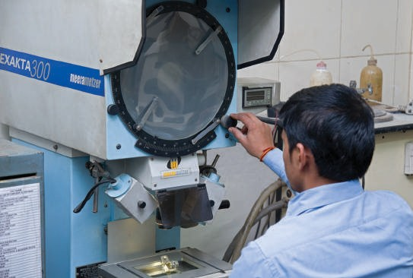
Quality Assurance
Forgings, Machined Forgings & Sheet Metal Stampings are put to rigid testing procedures to achieve the desired quality parameters through the following testing equipments-
Spectro Analysis Image Analyzer Proﬁle Projector
Microscope with Photographic Attachment x 1500 Stereo EPT
Future Plans
C-S Apparatus
Hardness Tester (Rockwell & Brinell)
The management at Advance Forgings has drawn up a long-term business plan to increase its presence both in
domestic and international market
by supplementing its capacity in all verticals
Magnetic Particle Inspection (MPI)
The in-house metallurgical lab also ensures the quality of incoming raw materials used for manufacturing.

Slide 10


CSR
On the social front, AFPL has striven hard to achieve not only the business goals but also serve the masses as part of its corporate social responsibility through assorted programmes like-
Maintenance of Cleanliness in and around the plant
Hosting Community get-togethers
Scholarship for deserving students from poor families
Helping the ‘have-nots’ in their hours of distress
Organizing Health Camps
ESI PF Camps
Environmental Policy
Advance Forgings goes beyond the call of duty when it comes to protecting and enhancing the quality of environment. The company is committed to conduct its business in ways that protect and preserve the environment by establishing different baseline programs. It has embarked upon a novel program to promote mass awareness on environmental conservation.
With a view to control and minimize the levels of pollution, the company has converted all the conventional production furnaces into modern electric furnaces. This initiative of the company has not only improved the working environment within the plant premises, but also bettered the environment in its surroundings.

Slide 11
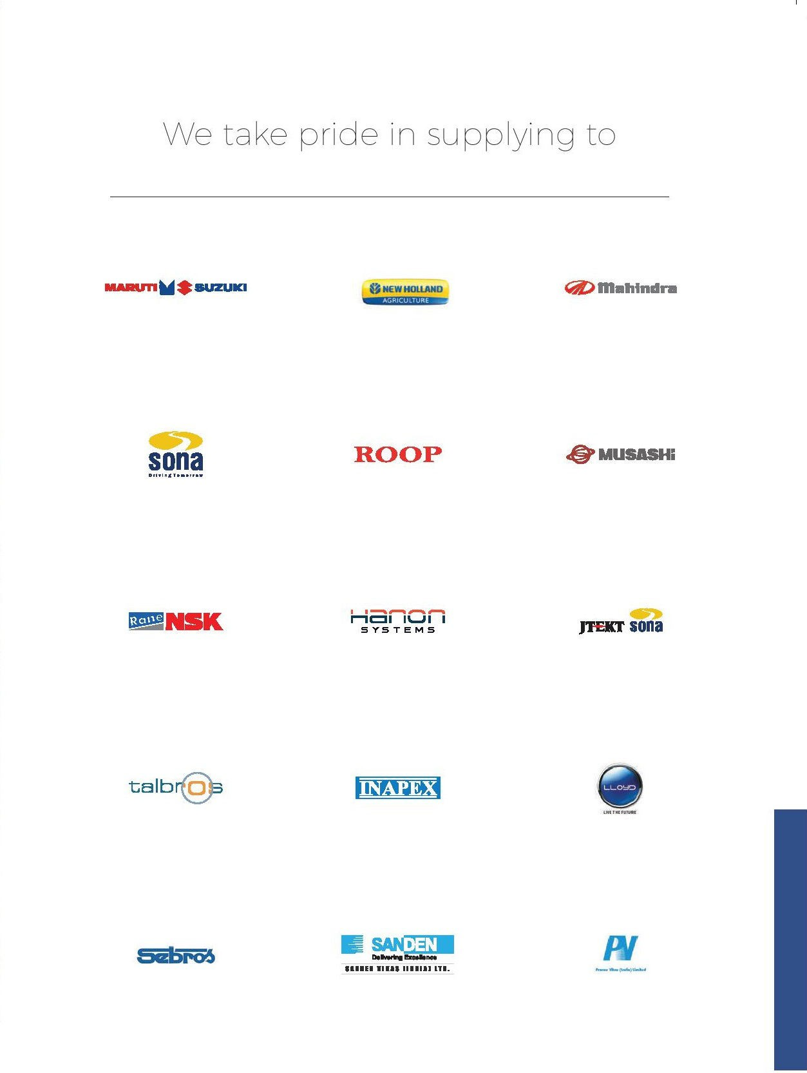

Slide 12
